Slide 1
Portuguese Bank Classification Task
Tomas Kluge – Capstone 2 project

Slide 2
Summary
The goal was to create a model to predict which clients would sign-up for a savings product after an advertising campaign
The method used were dummy classifier (benchmark), random forest, logistic regression and decision tree
The overall score was quite high for all models, but as a business solutions was more interested in the recall score that was very low for all the methods

Slide 3
Content
Overview of the project
Data wrangling
Exploratory data analysis
Statistical analysis
Modelling

Slide 4
Overview of the project
The Aim was to classify the clients into group that would be more likely to buy a savings product
Model that would enable to target the potential clients
The marketing campaigns would be more efficient

Slide 5
Overview of the project
The dataset was obtained clean and anonymised
The datasets were in the short and long form, where the long one also incorporated macro-economic variables
The independent variables were related to client data
The target variable was if the client started savings account a´fter the marketing campaign
Approach

Slide 6
Overview of the project
Independent variables
- BaNK CLIENT DATA
- DATA related with the last contact of the current campaign
- OTHER ATTRIBUTES
- social and economic context attributes
Dependent variables
- has the client subscribed a term deposit? (binary: 'yes','no')
Data

Slide 7
Data Overview
The data consists of 21 columns and 41188 rows

Slide 8
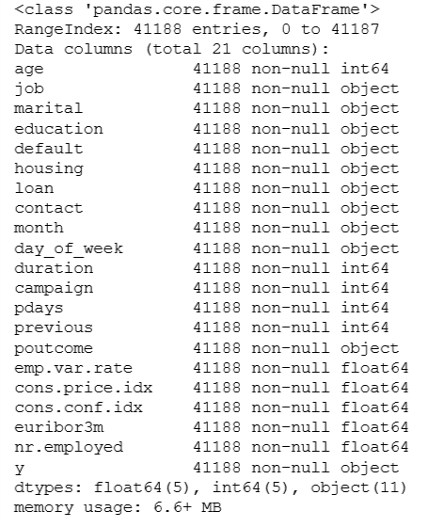
Data Overview
The data are mostly object (11), float (5)
or integers (5)
No missing data
Data

Slide 9
Exploratory Data Analysis
Basic overview of the variables both univariate and bivariate graphs
Statistical overview

Slide 10
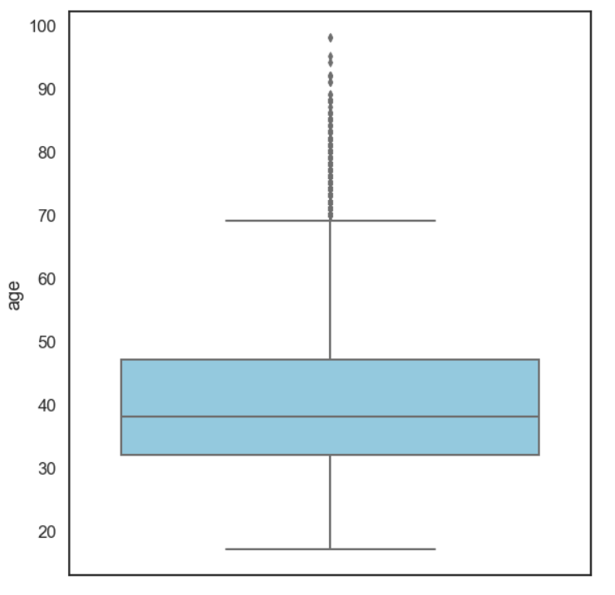
Age Structure
HALF OF THE CLIENTS ARE IN THE PRODUCTIVE AGE OF 35-45 YEARS
SIGNIFICANT OUTLIERS IN THE OLD AGE

Slide 11
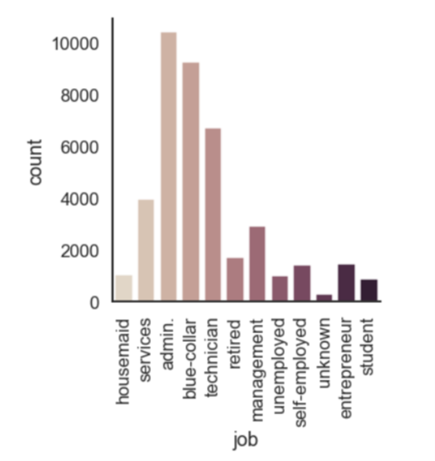
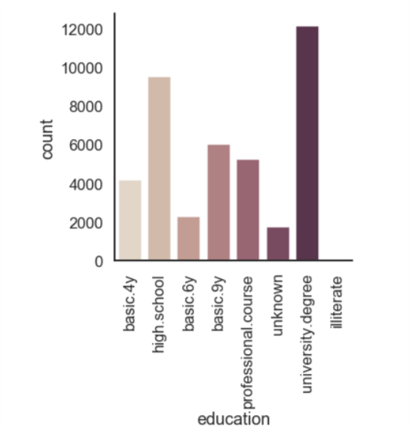
Client Structure
MAJORITY OF THE CLIENTS HAVE BLUE-COLLAR AND ADMIN JOBS OR ARE TECHNICIANS
CORRESPONDINGLY THE EDUCATION IS MOSTLY HIGH-SCHOOL AND UNIVERSITY

Slide 12
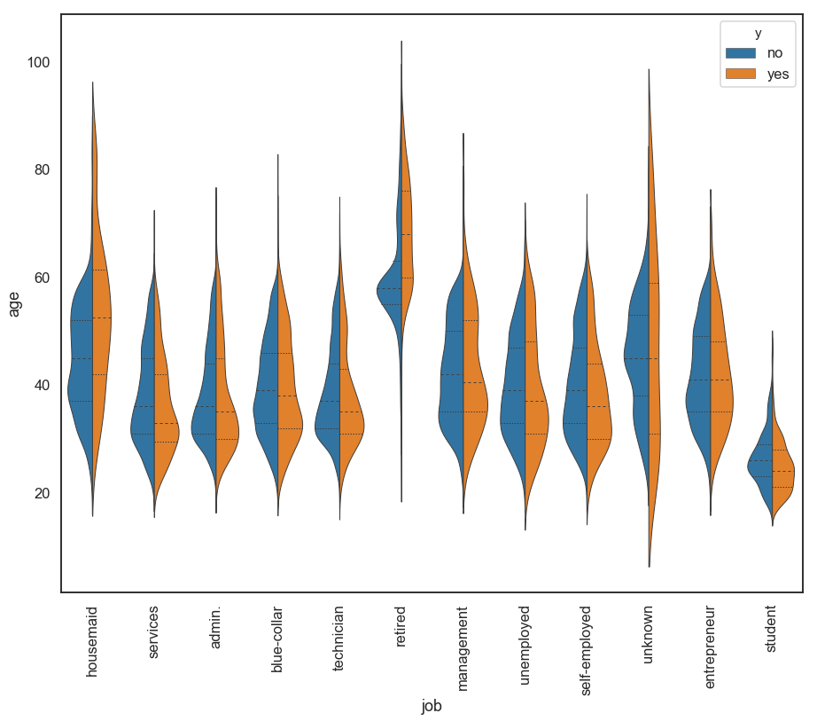
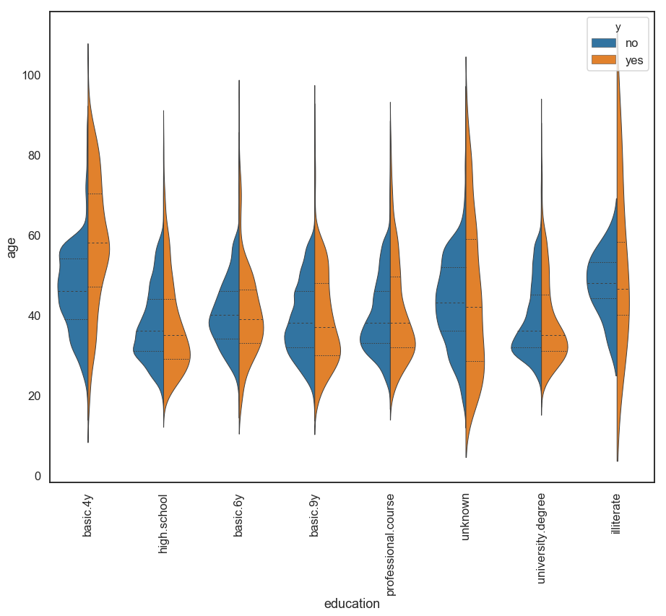
YES/NO BREAKDOWN
HIGH YES RATE BY OLDER RETIREES AND ALSO BLUE COLLAR AND TECHNICIANS
BETTER ACCEPTANCE AMONG THE PROFESSIONAL EDUCATION AND HIGH SCHOOL

Slide 13
Statistical Analysis
Due to the nature of the data, the only meaningful statistical analysis was to do correlation tables
There were strong correlations only in the social and economic attributes data

Slide 14
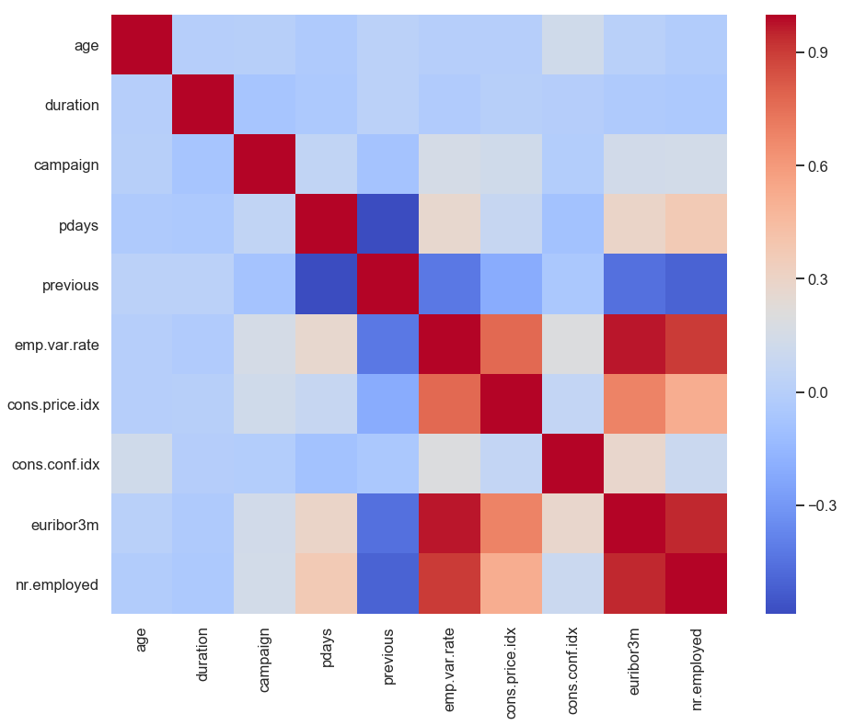
CLIENT RELATED DATA ARE UNCORRELATED; A SURPRISING FINDING
Statistical analysis

Slide 15
Machine Learning
The modelling was done by scikit-learn
The models used were dummy classifier as a benchmark, random forest, logistic regression and decision tree
The evaluation was by the confusion matrix

Slide 16
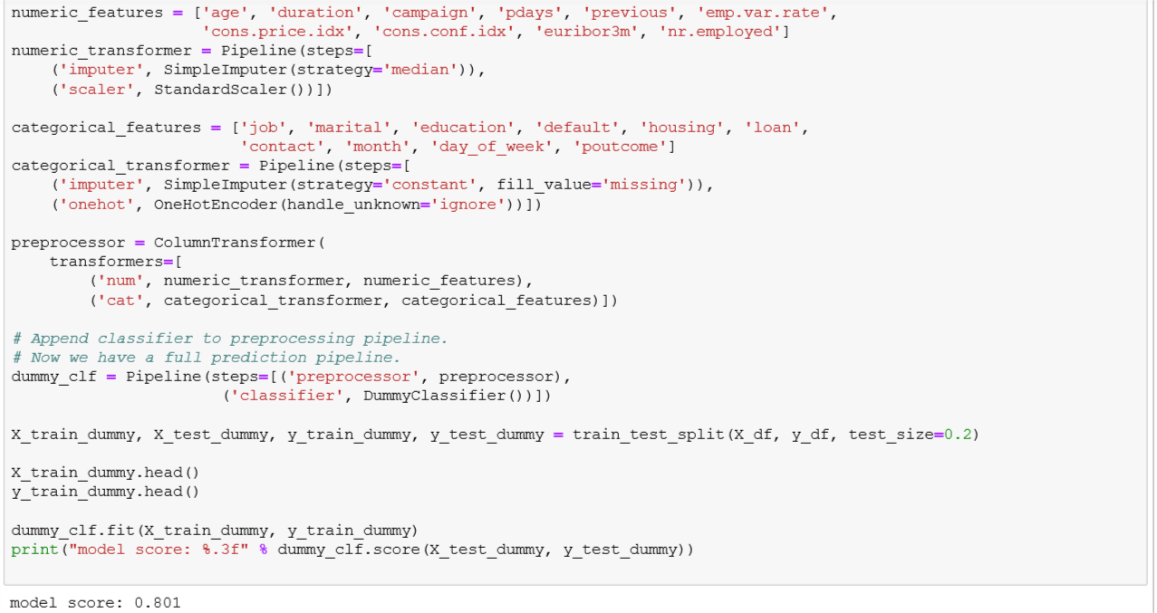
Dummy Classifier

Slide 17
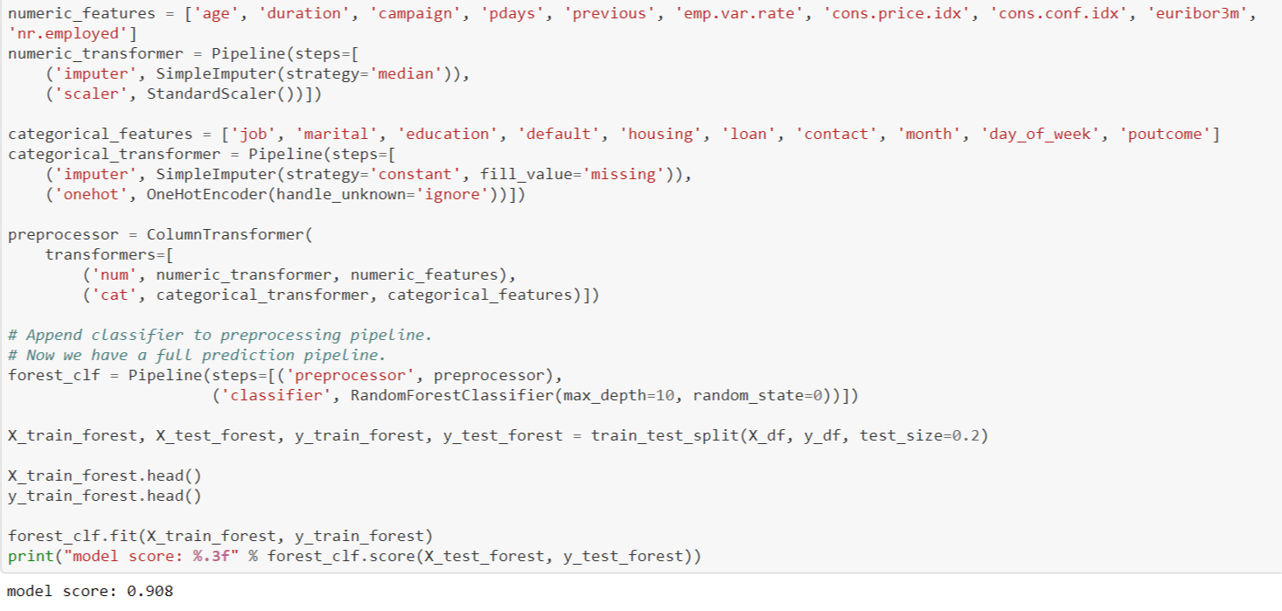
Random Forest
overview

Slide 18
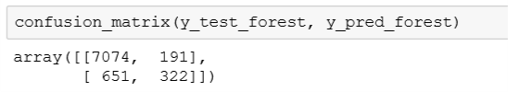

Random Forest
Confusion matrix and recall score

Slide 19
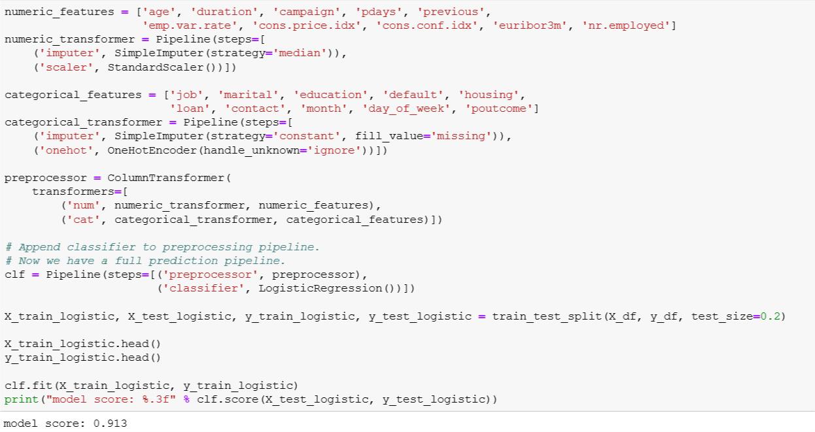
Logistic regression
Overview

Slide 20
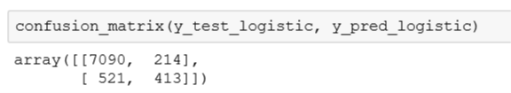
Logistic regression
Confusion matrix and recall score

Slide 21
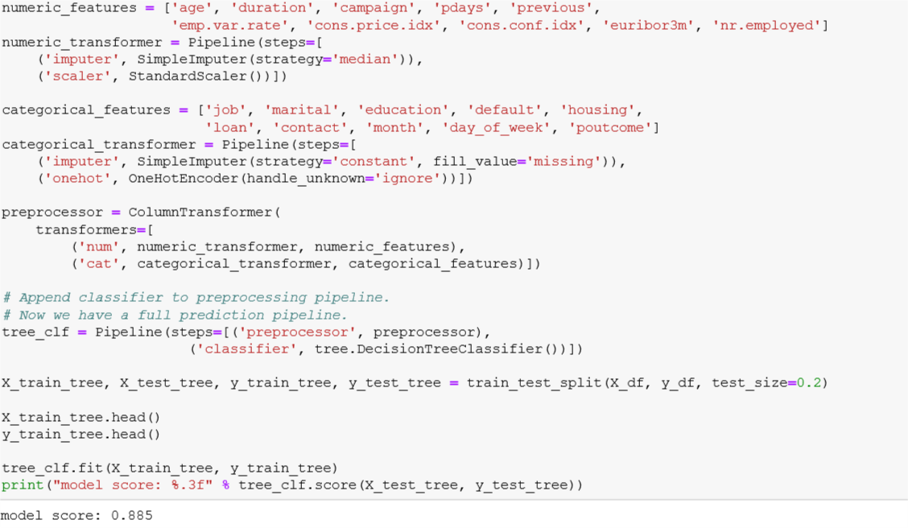
Decision Tree
Overview

Slide 22

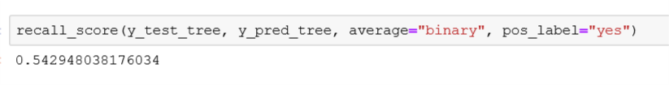
Decision Tree
Confusion matrix and recall score

Slide 23
OVERALL ALL OF THE MODELS EXCEEDED THE ACCURACY OF THE BENCHMARK DUMMY CLASSIFIER MODEL
THE HIGHEST ACCURACY IS THE LOGISTIC REGRESSION AT 0.913, HOWEVER THE STAKEHOLDER IS INTERESTED MORE IN RECALL SCORE
THE RECALL SCORE IS THE HIGHEST AT THE DECISION TREE MODEL; BUT OVERALL QUITE LOW AT 0.542
Conclusion

